Slide 1
ALGEBRA

Slide 2
ALGEBRA
Algebra
Introduction
Degree of a polynomial
Unique, No or Infinite solution conditions.
How to solve linear equations
Finding sum and product of roots of quadratic equation & Forming the quadratic equation
How to calculate roots of quadratic equation
Identity based questions
Miscellaneous questions
Data Sufficiency

Slide 3
ALGEBRA
:
1. Quadratic Equations:
(i) An equation of the type ax² + bx + c =0 is called the quadratic equation.
(ii) The highest power of the variable is called the degree of an equation.
(iii) An equation will have as many solutions as its degree. If an equation is of n degree, it will have 'n' solutions.
(iv) The solution of an equation is the value by which equation is satisfied. The values of the solution of an equation are also called the roots of the equation. This quadratic equation has two solutions.

Slide 4

ALGEBRA
:
2. Solving Quadratic Equations:
Any quadratic equation can be either solved by the factor method or by formula.
(i) By the factor method: First find the factors of the given equation making the right-hand side equal to zero and then by equating the factors to zero, we get the values of the variable.
(ii) By Formula: Consider a quadratic equation ax² + bx + c = 0,for finding the roots of the equation, we use the following formula:
Here + and - in the above formula is used to get the two values of x. Here the quantity b² - 4ac is called the discriminant.

Slide 5

ALGEBRA
:
3. Roots of the Quadratic Equation:
The value of the x that we obtain from a quadratic equation is called the root of the equation; α and β are used to denote the roots of the equation.
(i) Sum of the roots of a quadratic equation:
ax² + bx + c = 0 is equal to i.e.,α+β=
(ii) The product of the roots is equal to c/a i.e.,αβ= c/a
(iii) Consider a quadratic equation: ax² + bx + c = 0. For this equation, the roots will be equal if b² = 4ac. The roots will be unequal and real if b² > 4ac. The roots will be unequal and unreal if b² < 4ac.
4. Whenever we are given the roots of a quadratic equation, then the equation will be x² - (Sum of the roots)x + product of roots = 0.

Slide 6
ALGEBRA
1.What is the degree of following polynomial
6x⁵ + 7x³ + 8x⁵+ 3x²+ 5 + 8x + 4
A.5 B.4 C.3 D.1
Notes:
Option A
Easy (Compulsory)

Slide 7

ALGEBRA
2.What is the degree of the polynomial?
A.6 B.4 C.5 D.3
Notes:
Option C
Easy (Compulsory)

Slide 8
ALGEBRA
3. Find weather the following system 3x+9y=−6 and −4x−12y=8. is having:
Unique solution B. No solution
C. Infinite solution D. cannot be determined
Notes:
Option C
Easy (Compulsory)

Slide 9
ALGEBRA
4. For the system of equation 5x+3y=20 and 6x+2y=3 the graphs are:
Intersecting B. Parallel
C. Overlapping D. Cannot be determined
Notes:
Option A
Easy (Compulsory)

Slide 10
ALGEBRA
5. There are 120 legs and 50 heads of some ducks and horses grazing in a field. Find the number of horses
A. ­20 B. 10 C. 30 D. 40
Notes:
Option B
Easy (Compulsory)

Slide 11
ALGEBRA
6. A vessel, full of water, weighs 16.5 kg. When the vessel is 1/4 full, it weighs 5.25 kg. Find the weight of the empty vessel.
15 kg B. 10 kg C. 1.5 kg D. 5.25 kg
Notes:
Option C
Easy (Optional)

Slide 12
ALGEBRA
7. The sum of the digits of a 2 - digit number is 9. If we add 27 to the number, the new number obtained is a number formed by interchange of the digits. Find the number.
A. 36 B. 63 C. 54 D. 45
Notes:
Option A
Moderate (Compulsory)

Slide 13
ALGEBRA
8. Sudhir has 30 handkerchiefs and socks. If he had 5 more handkerchiefs and 5 less socks, the number of handkerchiefs becomes 5 times the number of socks. Find the original number of handkerchiefs and socks respectively.
A. 25 & 5 B. 18, 12 C. 20, 10 D. 24, 6
Notes:
Option C
Moderate (Optional)

Slide 14
ALGEBRA
9.A milkman has cows, buffaloes and goats. The number of goats is 5/2 times the number of cows and the number of cows is 5/2 times the number of buffaloes. If the total number of cows, buffaloes and goats is 39, find the number of goats the milkman owns.
A. 25 B. 10 C. 4 D. 21
Notes:
Option A
Moderate (Optional)

Slide 15
ALGEBRA
10. Two hackers planned to hack a bank account which had debit card pin code in such a format that if a fraction could be made using the first two digits as numerator and last two digits as denominator, then if the numerator of the fraction was increased by 200% and the denominator by 300%, the fraction becomes 12/15. What was the pin of the debit card?
A. 1889 B. 1660 C. 4850 D. 1615
Notes:
Option D
Expert (Optional)

Slide 16
ALGEBRA
11. A boy was asked to find 8/9th of a fraction. He made a mistake of dividing the fraction by 8/9 and so got an answer which exceeds the correct answer by 17/54. Find the original fraction?
2/3 B. ¾ C. 4/3 D. 3/5
Notes:
Option C
Expert (Compulsory)

Slide 17
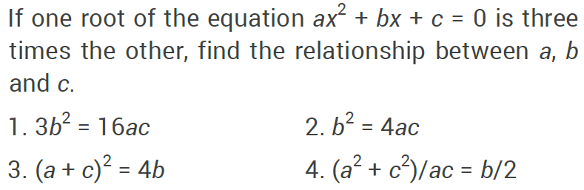
ALGEBRA
12.
Notes:
Option 1
Easy (Compulsory)

Slide 18
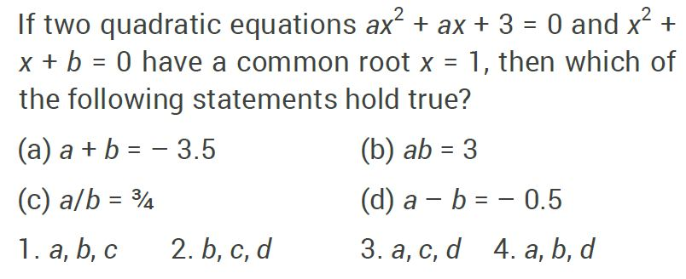
ALGEBRA
13.
Notes:
Option 1
Easy (Optional)

Slide 19
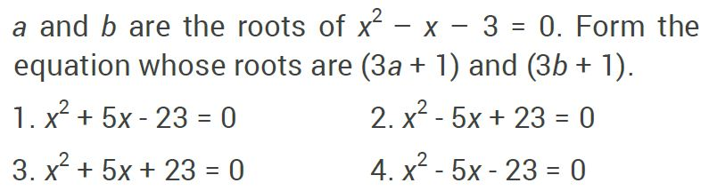
ALGEBRA
14.
Notes:
Option 4
Moderate (Compulsory)

Slide 20
ALGEBRA
15.
A. 1 B. 55 C. 97 D. none of these
Notes:
Option-C
Moderate (Optional)

Slide 21
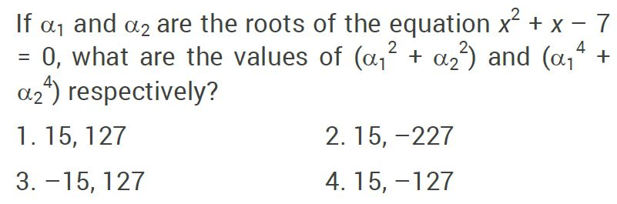
ALGEBRA
16.
Notes:
Option 1
Moderate (Compulsory)

Slide 22
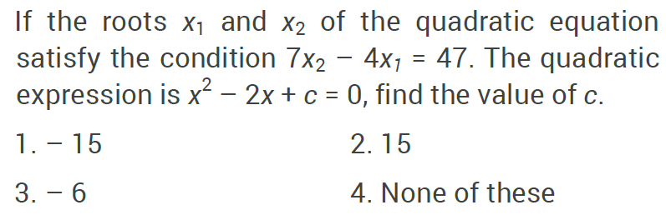
ALGEBRA
17.
Notes:
Option 1
Moderate (Optional)

Slide 23
ALGEBRA
18. If p and q are the roots of the equation x² - bx + c = 0, what is the equation if the roots are (pq + p + q) and (pq - p - q)?
A. x² - 2cx + (c² - b²) = 0
B. x² - 2bx + (b² + c²) = 0
C. bcx² - 2(b + c)x + c² = 0
D. x² + 2bx - (c² - b²) = 0
Notes:
Option-A
Expert (Compulsory)

Slide 24
ALGEBRA
19. In the given question, two equations numbered l and II are given. You have to solve both the equations and mark the appropriate answer
I. a² - 9a + 14 = 0
II. 3b² + 9b + 6 = 0
a < b B. a > b C. a ≤ b D. a ≥ b
E. a = b or the relationship cannot be determined
Notes:
Option B
Easy (Compulsory)

Slide 25
ALGEBRA
20. In the given question, two equations numbered l and II are given. You have to solve both the equations and mark the appropriate answer
I. 2a² + 28a + 98 = 0
II. 9b² - 2b - 7 = 0
a < b B. a > b C. a ≤ b D. a ≥ b
E. a = b or the relationship cannot be determined
Notes:
Option A
Moderate (Compulsory)

Slide 26
ALGEBRA
21. If a + b = 17 and a – b = 9 then the value of (4a² + 4b²) is,
710 B. 720 C. 730 D. 740
Notes:
Option D
Easy (Compulsory)

Slide 27
ALGEBRA
22. If a + b + c = 9, ab + bc + ca = 26, a³ + b³ = 91, b³ + c³ = 72 and c³ + a³ = 35, then what is the value of abc?
A.48 B.24 C.36 D.42
Notes:
Option B
Expert (Compulsory)

Slide 28

ALGEBRA
23.
A. 80 B. 90 C. 100 D. 110
Notes:
Option-B
Moderate (Compulsory)

Slide 29

ALGEBRA
24.
A. 0 B. 9 C. 3√3 D. √3
Notes:
Option A
Expert (Compulsory)

Slide 30

ALGEBRA
25.
A. 25 B. 26 C. 30 D. 40
Notes:
Option C
Expert (Optiional)

Slide 31
ALGEBRA
26. Direction:- Below question is followed by two statements I and II. You have to determine whether the data given in the statements are sufficient for answering the question. You should use the data your knowledge of Mathematics to choose between the possible answers
What is the two digit number in which unit’s place digit is greater than digit at ten’s place?
I. The difference between the two digits of the number is 2
II. The sum of the two digits of the number is 8
A) I alone sufficient while II alone not sufficient to answer
B) II alone sufficient while I alone not sufficient to answer
C) Either I or II alone sufficient to answer
D) Both I and II are not sufficient to answer
E) Both I and II are necessary to answer
Notes:
Option E
Easy (Compulsory)

Slide 32
ALGEBRA
27. Find the value of x.
Statement I: 2xyz + 6y – 8z + 5 = 0, z = 1
Statement II: y = √ (225 - 116)
Statement III: 4xyz – 6z + 8y – 7 = 0, z = 3
The data in statements I alone is sufficient to answer the question, while the data in statement II and III is not sufficient to answer the question.
B. The data in statements II and III is sufficient to answer the question, while the data in statement I is not sufficient to answer the question.
C. The data in statements I and II or in statement II and III is sufficient to answer the question.
D. The data in all the statements I, II and III is not sufficient to answer the question.
E. The data in all the statements I, II and III together is necessary to answer the question
Notes:
Option C
Expert (Compulsory)

Slide 33
ALGEBRA
28. Find the two digit number.
Statement I: The product of the two digits of the two digit number is 20.
Statement II: The difference between the two digits of the two digit numbers is 1.
Statement III: The sum of the two digits of the two digit numbers is 9.
The data in statements I alone is sufficient to answer the question, while the data in statement II and III is not sufficient to answer the question.
B. The data in statements II and III is sufficient to answer the question, while the data in statement I is not sufficient to answer the question.
C. The data in statements I and II or in statement II and III is sufficient to answer the question.
D. The data in all the statements I, II and III is not sufficient to answer the question.
E. The data in all the statements I, II and III together is necessary to answer the question.
Notes:
Option D
Expert (Optional)

Slide 34
ALGEBRA
Any Doubts??
Notes:
Option D

